Slide 1
Introduction to estimating β from an infection assay
Overview:
The logic: Simplifying the S-I framework
Units: Trickier than you might think!
Optimizers: How to do it in R
Extensions: Building complexity & realism
Insights: What can this approach teach us?
BONUS!!!: Estimating foraging rate from foraging assay

Slide 2
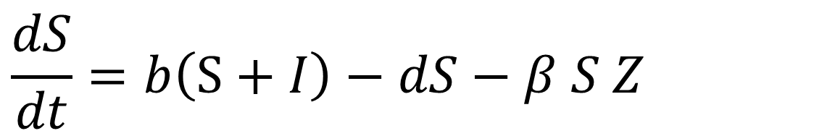
1. The logic: Simplifying the S-I framework
Generic S-I ODE equations describe dynamics of environmentally transmitted microparasite in host population.
$$\frac{dS}{dt}=b\left(S+I\right)−dS−β S Z$$
*The model here is constructed to reflect epidemiology of Daphnia-Metschnikowia system, but could be easily modified

Slide 3
1. The logic: Simplifying the S-I framework
Generic S-I ODE equations describe dynamics of environmentally transmitted microparasite in host population.
$$\frac{dS}{dt}=b\left(S+I\right)−dS−β S Z$$
Birth rate (b) of hosts (both S and I reproduce)

Slide 4
1. The logic: Simplifying the S-I framework
Generic S-I ODE equations describe dynamics of environmentally transmitted microparasite in host population.
$$\frac{dS}{dt}=b\left(S+I\right)−dS−β S Z$$
Birth rate (b) of hosts (both S and I reproduce)
Background death rate (d) of susceptible hosts, S

Slide 5
1. The logic: Simplifying the S-I framework
Generic S-I ODE equations describe dynamics of environmentally transmitted microparasite in host population.
$$\frac{dS}{dt}=b\left(S+I\right)−dS−β S Z$$
Birth rate (b) of hosts (both S and I reproduce)
Transmission, as susceptible hosts S contact parasites Z and become infected…
According to the magical & mysterious transmission rate, β
Background death rate (d) of susceptible hosts, S

Slide 6
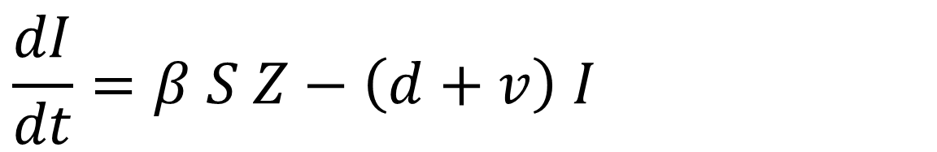
1. The logic: Simplifying the S-I framework
Generic S-I ODE equations describe dynamics of environmentally transmitted microparasite in host population.
$$\frac{dS}{dt}=b\left(S+I\right)−dS−β S Z$$
$$\frac{dI}{dt}=β S Z−\left(d+v\right) I$$
Transmission, as susceptible hosts S contact parasites Z and become infected…
According to the magical & mysterious transmission rate, β

Slide 7
1. The logic: Simplifying the S-I framework
Generic S-I ODE equations describe dynamics of environmentally transmitted microparasite in host population.
$$\frac{dS}{dt}=b\left(S+I\right)−dS−β S Z$$
$$\frac{dI}{dt}=β S Z−\left(d+v\right) I$$
Transmission, as susceptible hosts S contact parasites Z and become infected…
According to the magical & mysterious transmission rate, β
Infected hosts die faster due to additional virulence, v…

Slide 8
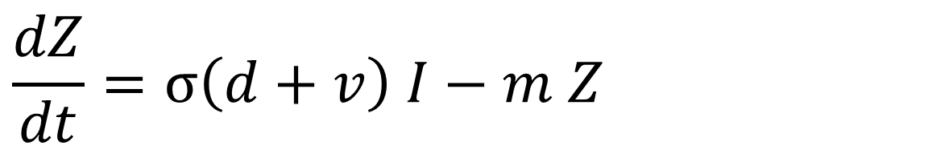
1. The logic: Simplifying the S-I framework
Generic S-I ODE equations describe dynamics of environmentally transmitted microparasite in host population.
$$\frac{dS}{dt}=b\left(S+I\right)−dS−β S Z$$
$$\frac{dI}{dt}=β S Z−\left(d+v\right) I$$
$$\frac{dZ}{dt}=σ\left(d+v\right) I−m Z$$
Infected hosts die faster due to additional virulence, v…

Slide 9
1. The logic: Simplifying the S-I framework
Generic S-I ODE equations describe dynamics of environmentally transmitted microparasite in host population.
$$\frac{dS}{dt}=b\left(S+I\right)−dS−β S Z$$
$$\frac{dI}{dt}=β S Z−\left(d+v\right) I$$
$$\frac{dZ}{dt}=σ\left(d+v\right) I−m Z$$
Infected hosts die faster due to additional virulence, v… releasing σ spores into the environment

Slide 10
1. The logic: Simplifying the S-I framework
Generic S-I ODE equations describe dynamics of environmentally transmitted microparasite in host population.
$$\frac{dS}{dt}=b\left(S+I\right)−dS−β S Z$$
$$\frac{dI}{dt}=β S Z−\left(d+v\right) I$$
And spores of the parasite are lost at some mortality rate m that includes sinking, consumption, decomposition, etc.
$$\frac{dZ}{dt}=σ\left(d+v\right) I−m Z$$

Slide 11
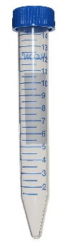
1. The logic: Simplifying the S-I framework
Which parts of the dynamics described by these equations are relevant during an 8-hour infection assay??
$$\frac{dS}{dt}=b\left(S+I\right)−dS−β S Z$$
Infection assay:
$$\frac{dI}{dt}=β S Z−\left(d+v\right) I$$
S
?
$$\frac{dZ}{dt}=σ\left(d+v\right) I−m Z$$
Z
S and Z go in…
Does S or I come out?

Slide 12
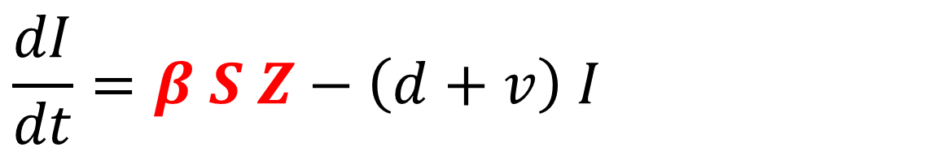
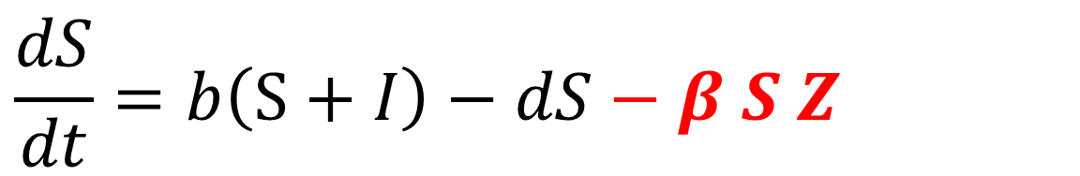
1. The logic: Simplifying the S-I framework
Which parts of the dynamics described by these equations are relevant during an 8-hour infection assay??
$$\frac{dS}{dt}=b\left(S+I\right)−dS−β S Z$$
Infection assay:
$$\frac{dI}{dt}=β S Z−\left(d+v\right) I$$
S
?
$$\frac{dZ}{dt}=σ\left(d+v\right) I−m Z$$
Z
S and Z go in…
Does S or I come out?

Slide 13
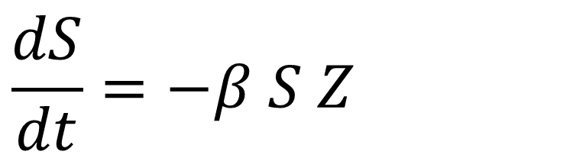
1. The logic: Simplifying the S-I framework
So we are left with:
$$\frac{dS}{dt}=−β S Z$$

Slide 14
1. The logic: Simplifying the S-I framework
So we are left with:
$$\frac{dS}{dt}=−β S Z$$
We can solve this differential equation for S at time t…
$$S_{t}=S_{0} exp(−β Z t)$$
And then do some algebra to rearrange in terms of beta…

Slide 15
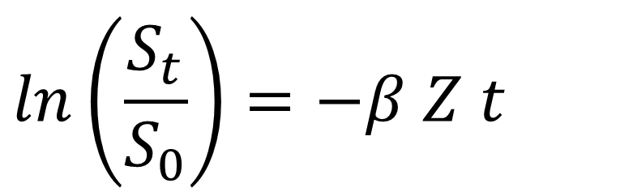
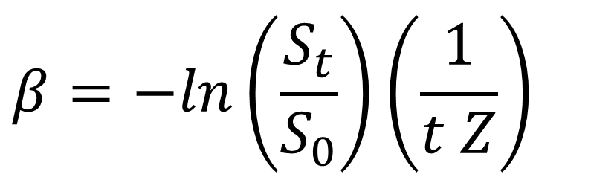
1. The logic: Simplifying the S-I framework
So we are left with:
$$\frac{dS}{dt}=−β S Z$$
We can solve this differential equation for S at time t…
$$S_{t}=S_{0} exp(−β Z t)$$
And then do some algebra to rearrange in terms of beta…
$$ln\left(\frac{S_{t}}{S_{0}}\right)=−β Z t$$
$$β=−ln\left(\frac{S_{t}}{S_{0}}\right)\left(\frac{1}{t Z}\right)$$
Before we use the equation, lets return to the experiment and think through units.

Slide 16
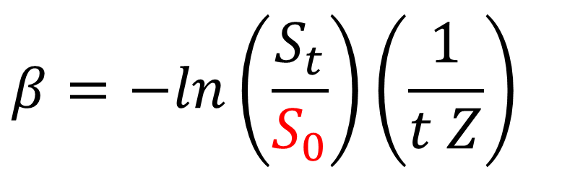
2. Units: Trickier than you might think!
What units should β take? What units do the other parameters in the equation have?
$$β=−ln\left(\frac{S_{t}}{S_{0}}\right)\left(\frac{1}{t Z}\right)$$
S₀: 1 hosts/tube, or 1/15 = 0.067 hosts/ml
Infection assay:
S
?
Z
S and Z go in…
Does S or I come out?

Slide 17
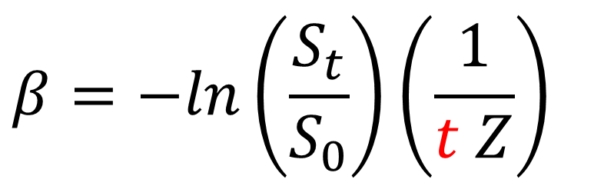
2. Units: Trickier than you might think!
What units should β take? What units do the other parameters in the equation have?
$$β=−ln\left(\frac{S_{t}}{S_{0}}\right)\left(\frac{1}{t Z}\right)$$
S₀: 1 hosts/tube, or 1/15 = 0.067 hosts/ml
t: length of the assay (8 hours, or 0.33 days)
Infection assay:
S
?
Z
S and Z go in…
Does S or I come out?

Slide 18
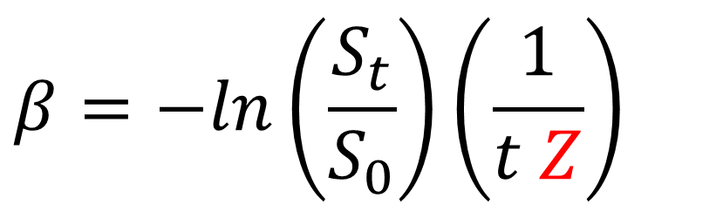
2. Units: Trickier than you might think!
What units should β take? What units do the other parameters in the equation have?
$$β=−ln\left(\frac{S_{t}}{S_{0}}\right)\left(\frac{1}{t Z}\right)$$
S₀: 1 hosts/tube, or 1/15 = 0.067 hosts/ml
t: length of the assay (8 hours, or 0.33 days)
Z: spores you put in tube (200/ml)
Infection assay:
S
?
Z
S and Z go in…
Does S or I come out?

Slide 19
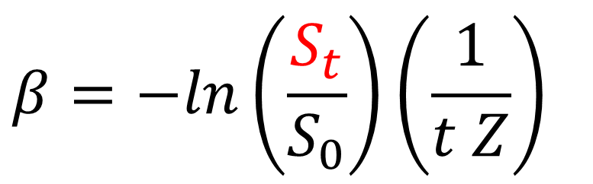
2. Units: Trickier than you might think!
What units should β take? What units do the other parameters in the equation have?
$$β=−ln\left(\frac{S_{t}}{S_{0}}\right)\left(\frac{1}{t Z}\right)$$
S₀: 1 hosts/tube, or 1/15 = 0.067 hosts/ml
t: length of the assay (8 hours, or 0.33 days)
Z: spores you put in tube (200/ml)
S_{t}: either 0 (if infected), or 0.067 hosts/ml (if not)
Infection assay:
S
?
Z
S and Z go in…
Does S or I come out?

Slide 20
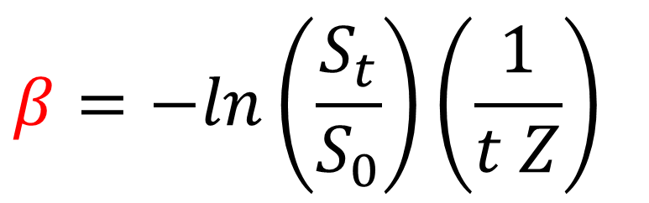
2. Units: Trickier than you might think!
What units should β take? What units do the other parameters in the equation have?
$$β=−ln\left(\frac{S_{t}}{S_{0}}\right)\left(\frac{1}{t Z}\right)$$
S₀: 1 hosts/tube, or 1/15 = 0.067 hosts/ml
t: length of the assay (8 hours, or 0.33 days)
Z: spores you put in tube (200/ml)
S_{t}: either 0 (if infected), or 0.067 hosts/ml (if not)
β: takes on units of ml per day, depending on units for t and Z (host units cancel regardless)
Infection assay:
S
?
Z
S and Z go in…
Does S or I come out?

Slide 21
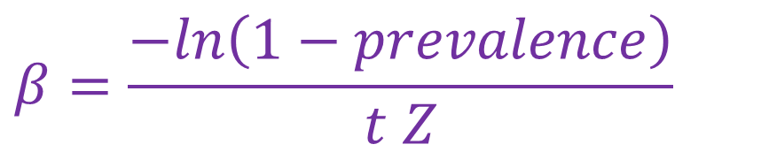
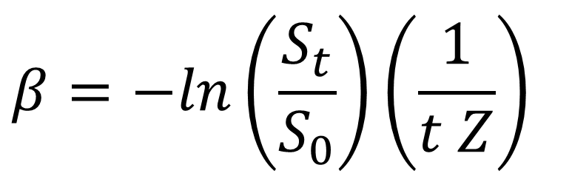
2. Units: Trickier than you might think!
So a quick & dirty estimate of beta:
$$β=\frac{−ln\left(1−prevalence\right)}{t Z}$$
$$β=−ln\left(\frac{S_{t}}{S_{0}}\right)\left(\frac{1}{t Z}\right)$$
This formula works if:
Hosts are all inoculated individually under identical conditions OR
Single group of hosts inoculated (no replication)
S₀: 1 hosts/tube, or 1/15 = 0.067 hosts/ml
t: length of the assay (8 hours, or 0.33 days)
Z: spores you put in tube (200/ml)
S_{t}: either 0 (if infected), or 0.067 hosts/ml (if not)
β: takes on units of ml per day, depending on units for t and Z (host units cancel regardless)

Slide 22
2. Units: Trickier than you might think!
So a quick & dirty estimate of beta:
$$β=\frac{−ln\left(1−prevalence\right)}{t Z}$$
$$β=−ln\left(\frac{S_{t}}{S_{0}}\right)\left(\frac{1}{t Z}\right)$$
This formula works if:
Hosts are all inoculated individually under identical conditions OR
Single group of hosts inoculated (no replication)
S₀: 1 hosts/tube, or 1/15 = 0.067 hosts/ml
t: length of the assay (8 hours, or 0.33 days)
Z: spores you put in tube (200/ml)
S_{t}: either 0 (if infected), or 0.067 hosts/ml (if not)
β: takes on units of ml per day, depending on units for t and Z (host units cancel regardless)
This formula DOES NOT WORK if:
Multiple groups of hosts exposed
Multiple parasite densities, host densities, or exposure durations
More complex model (e.g., w foraging depression) may not have analytical solution
If we want confidence intervals

Slide 23

3. Optimizers: How to do it in R
More general approach:
Use an optimizer algorithm to identify the parameter value that maximizes likelihood of observed outcomes, given the structure of your data and the error distributions that you assume
Book is free online!

Slide 24
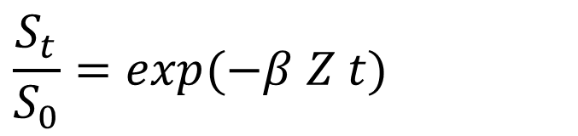
3. Optimizers: How to do it in R
For example: Infection outcomes for singly inoculated hosts should follow a Bernoulli distribution (special case of binomial distribution with n=1), with probability of infection = exp(-βZt)
Syntax in R:
uninfected ~ dbinom(size=1, prob=exp(-beta*exposure*time)
$$\frac{S_{t}}{S_{0}}=exp(−β Z t)$$

Slide 25
3. Optimizers: How to do it in R
Some other things to know about fitting parameters using maximum likelihood in R:
mle2 (the Ben Bolker package) uses R’s built-in optimizer, called optim
Usually several options for different algorithms, that may work better or worse for any given problem (e.g., L-BFGS-B)
Can estimate multiple parameters at once given sufficient data
Built-in options to ‘profile’ certainty
Can also bootstrap by subsampling data (typically 10,000x) and estimating parameter(s) every time; then look at 95% confidence intervals
I’m happy to share example code if you want – just ask.

Slide 26
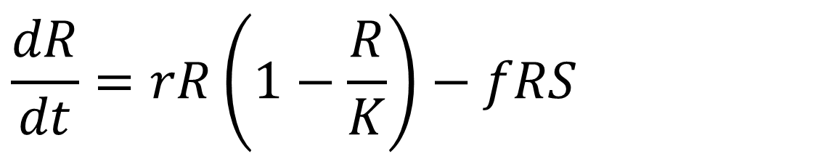
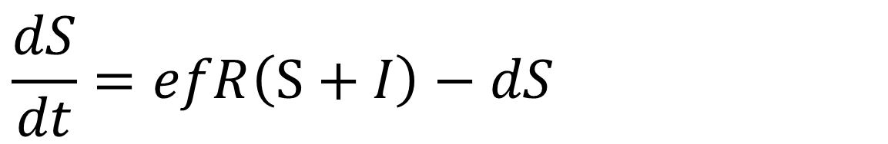
BONUS!!!! Same process to estimate feeding rate from feeding rate assay:
Start with equations to describe generic consumer-resource dynamics (this example shows a linear functional response with a susceptible host population and no disease)
$$\frac{dS}{dt}=efR\left(S+I\right)−dS$$
$$\frac{dR}{dt}=rR\left(1−\frac{R}{K}\right)−fRS$$

Slide 27
BONUS!!!! Same process to estimate feeding rate from feeding rate assay:
Start with equations to describe generic consumer-resource dynamics (this example shows a linear functional response with a susceptible host population and no disease)
$$\frac{dS}{dt}=efR\left(S+I\right)−dS$$
Now birth is a linear function of resource density (R), per capita foraging rate (f), and conversion efficiency of resources to births (e)
$$\frac{dR}{dt}=rR\left(1−\frac{R}{K}\right)−fRS$$
Resources grow logistically…
and are eaten by susceptible hosts

Slide 28
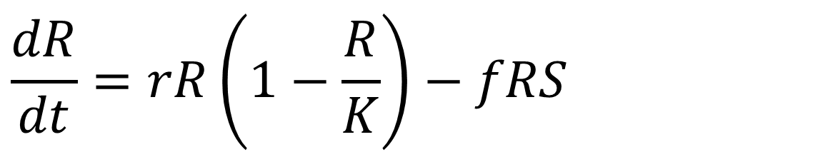
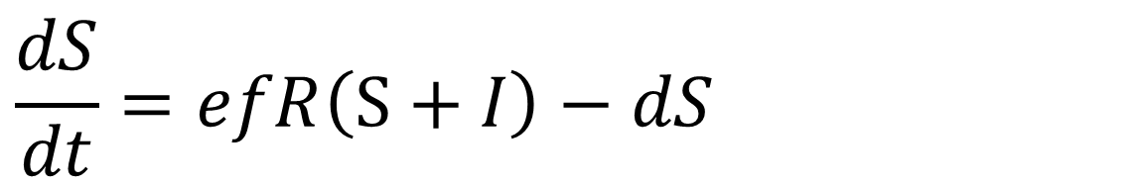
BONUS!!!! Same process to estimate feeding rate from feeding rate assay:
Which parts of the dynamics described by these equations are relevant in an 8-hour foraging assay??
$$\frac{dS}{dt}=efR\left(S+I\right)−dS$$
Infection assay:
$$\frac{dR}{dt}=rR\left(1−\frac{R}{K}\right)−fRS$$
S
?
R
S and A go in…
How much A is left after x time?

Slide 29
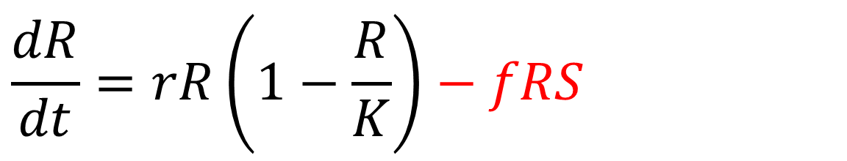
BONUS!!!! Same process to estimate feeding rate from feeding rate assay:
Which parts of the dynamics described by these equations are relevant foraging assay??
$$\frac{dS}{dt}=efR\left(S+I\right)−dS$$
Infection assay:
$$\frac{dR}{dt}=rR\left(1−\frac{R}{K}\right)−fRS$$
S
?
R
(We do these in the dark so that we can assume no algae growth)
S and A go in…
How much A is left after x time?

Slide 30
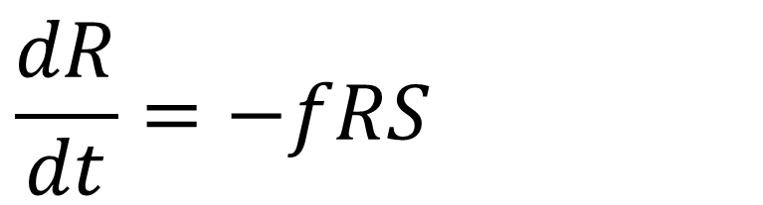
BONUS!!!! Same process to estimate feeding rate from feeding rate assay:
So we are left with:
$$\frac{dR}{dt}=−fRS$$

Slide 31
BONUS!!!! Same process to estimate feeding rate from feeding rate assay:
So we are left with:
$$\frac{dR}{dt}=−fRS$$
We can solve this differential equation for R at time t…
$$R_{t}=R_{0} exp(−f S t)$$
And then do some algebra to rearrange in terms of f…

Slide 32
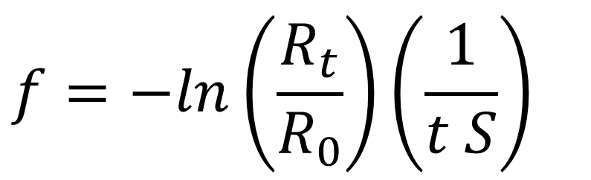
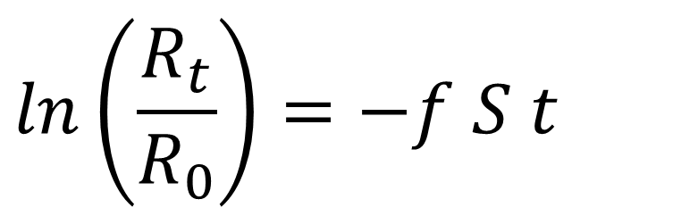
BONUS!!!! Same process to estimate feeding rate from feeding rate assay:
So we are left with:
$$\frac{dR}{dt}=−fRS$$
We can solve this differential equation for R at time t…
$$R_{t}=R_{0} exp(−f S t)$$
And then do some algebra to rearrange in terms of f…
$$ln\left(\frac{R_{t}}{R_{0}}\right)=−f S t$$
$$f=−ln\left(\frac{R_{t}}{R_{0}}\right)\left(\frac{1}{t S}\right)$$
Remember to think through units!!!

Slide 33
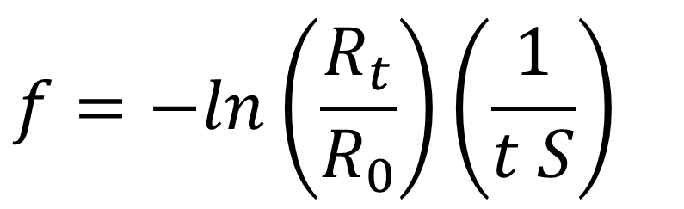
BONUS!!!! Same process to estimate feeding rate from feeding rate assay:
Some notes on units:
R_{t} and R₀ cancel (just like the S’s did for estimating transmission rate), so we typically just use RFUs (relative fluorescent units) of algae
Since we need estimates for both R_{t} and R₀, we typically include control algae tubes in a feeding rate assay (i.e., with no Daphnia)
If you express S as “hosts per ml” and t as “days”, then f takes units of ml per day (same as beta).
$$f=−ln\left(\frac{R_{t}}{R_{0}}\right)\left(\frac{1}{t S}\right)$$

Slide 34
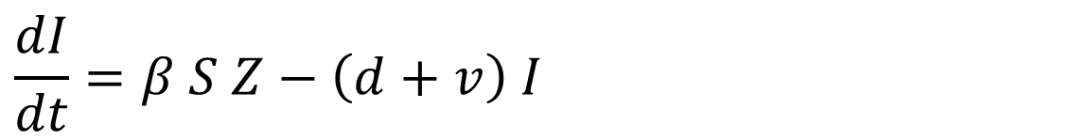
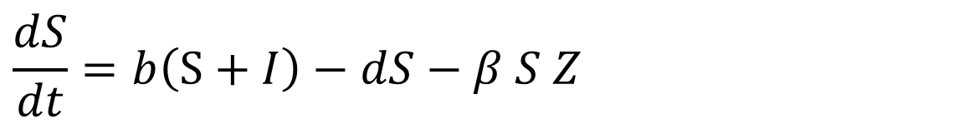
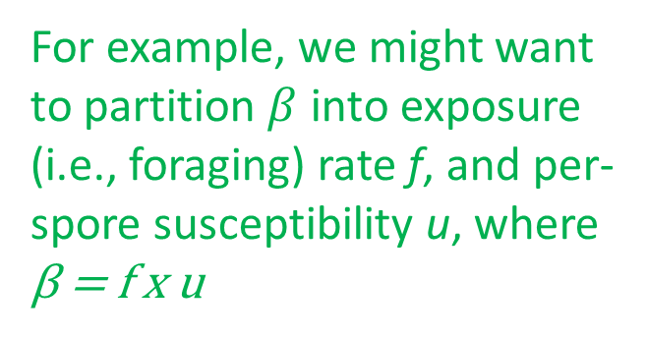
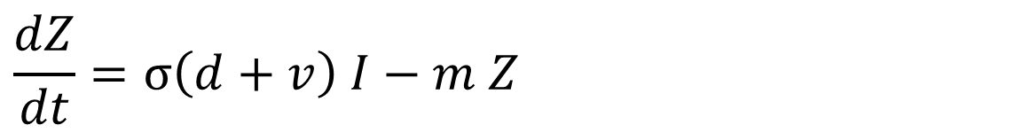
4. Extensions: Building complexity & realism
To develop more complex or realistic transmission models, go all the way back to the beginning, starting with the ODEs:
$$\frac{dS}{dt}=b\left(S+I\right)−dS−β S Z$$
$$\frac{dI}{dt}=β S Z−\left(d+v\right) I$$
For example, we might want to partition $β$ into exposure (i.e., foraging) rate f, and per-spore susceptibility u, where β = f x u
$$\frac{dZ}{dt}=σ\left(d+v\right) I−m Z$$

Slide 35
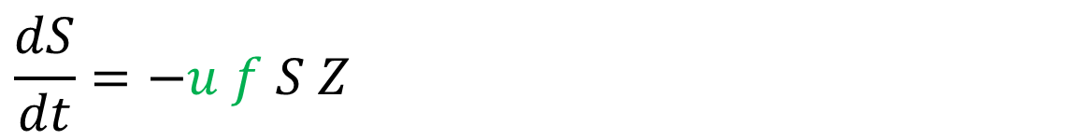
4. Extensions: Building complexity & realism
$$\frac{dS}{dt}=−u f S Z$$
For example, we might want to partition $β$ into exposure (i.e., foraging) rate f, and per-spore susceptibility u, where β = f x u
*To fit both f and u, we would need some additional data; specifically, foraging rate calculated in a foraging assay

Slide 36
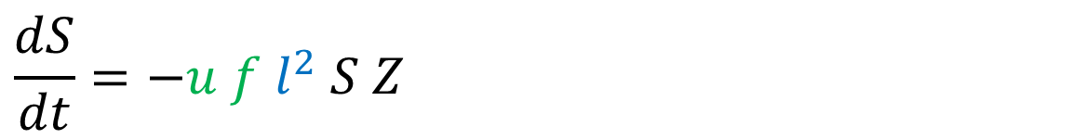
4. Extensions: Building complexity & realism
$$\frac{dS}{dt}=−u f l^{2} S Z$$
And since we know that foraging rates scale with body size (roughly squared), if we measured body size, we can estimate size-specific parameters:

Slide 37
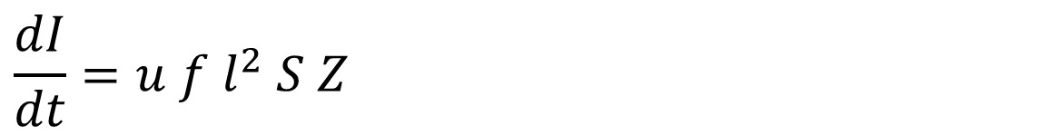
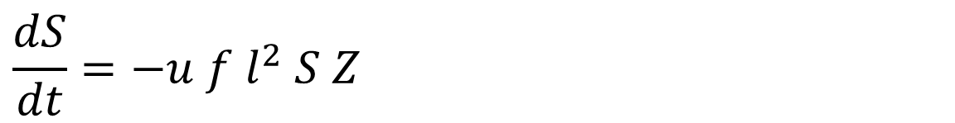
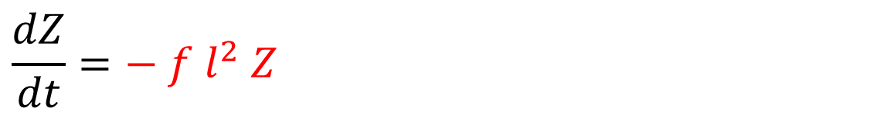
4. Extensions: Building complexity & realism
Sometimes, a more complex changes the expressions that we feed the optimizer. E.g., accounting for removal of spores during the infection assay due to foraging (Civitello et al. 2013 ELE)
$$\frac{dS}{dt}=−u f l^{2} S Z$$
$$\frac{dI}{dt}=u f{ l}^{2} S Z$$
$$\frac{dZ}{dt}=− f{ l}^{2} Z$$

Slide 38
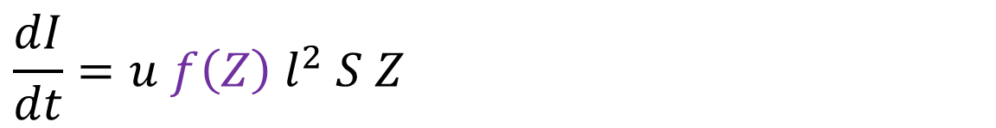
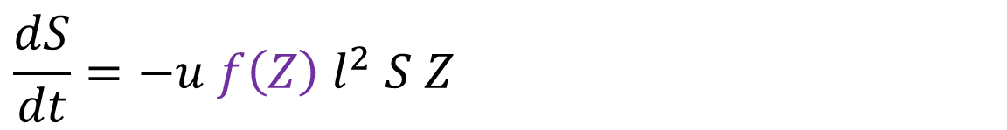
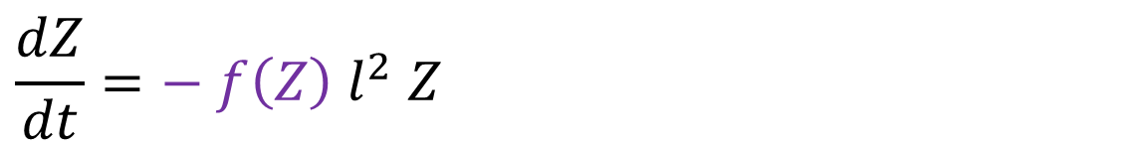
4. Extensions: Building complexity & realism
Sometimes we can’t solve the ODEs for a S at time t, and we have to simulate dynamics and ask the optimizer to pick the value of parameters that lets the outcome of simulations after 8 hours (or duration of the assay) best match the observed outcomes. E.g., when hosts consume parasite during foraging, but foraging rates are also a function of parasite spores in the environment
(Strauss et al. 2019 Proc B)
$$\frac{dS}{dt}=−u f\left(Z\right){ l}^{2} S Z$$
$$\frac{dI}{dt}=u f\left(Z\right){ l}^{2} S Z$$
$$\frac{dZ}{dt}=− f\left(Z\right){ l}^{2} Z$$

Slide 39
5. Insights: What can this approach teach us?
So why all the fuss? What has this approach taught us so far?
In general, fitting these parameters:
Teaches us about mechanisms underlying infection dynamics
Simultaneously arms us with parameters which can then be plugged back into ODE models to study feedbacks and outcomes at different scales

Slide 40
5. Insights: What can this approach teach us?
So why all the fuss? What has this approach taught us so far? A few examples:
High population density of hosts can actually inhibit disease transmission by slowing per-capita foraging/exposure rates via interference (Civitello et al. 2013 ELE)

Slide 41
5. Insights: What can this approach teach us?
So why all the fuss? What has this approach taught us so far? A few examples:
Effects of temperature on disease dynamics in this system are mostly driven by changes in host foraging rate, which increases with temperature (Shocket et al. 2018 Am Nat)

Slide 42
5. Insights: What can this approach teach us?
So why all the fuss? What has this approach taught us so far? A few examples:
Traits measured on individuals in foraging/infection assays can predict whether adding a second species will or will not reduce disease via a dilution effect at the community scale (Strauss et al. 2015 ELE)

Slide 43
5. Insights: What can this approach teach us?
So why all the fuss? What has this approach taught us so far? A few examples:
Host genotypes differ in defensive strategies including how steeply they slow their feeding when there are lots of parasites in the environment (Strauss et al. 2019 Proc B)

